Slide 1


Classics in the Bridge

Slide 2
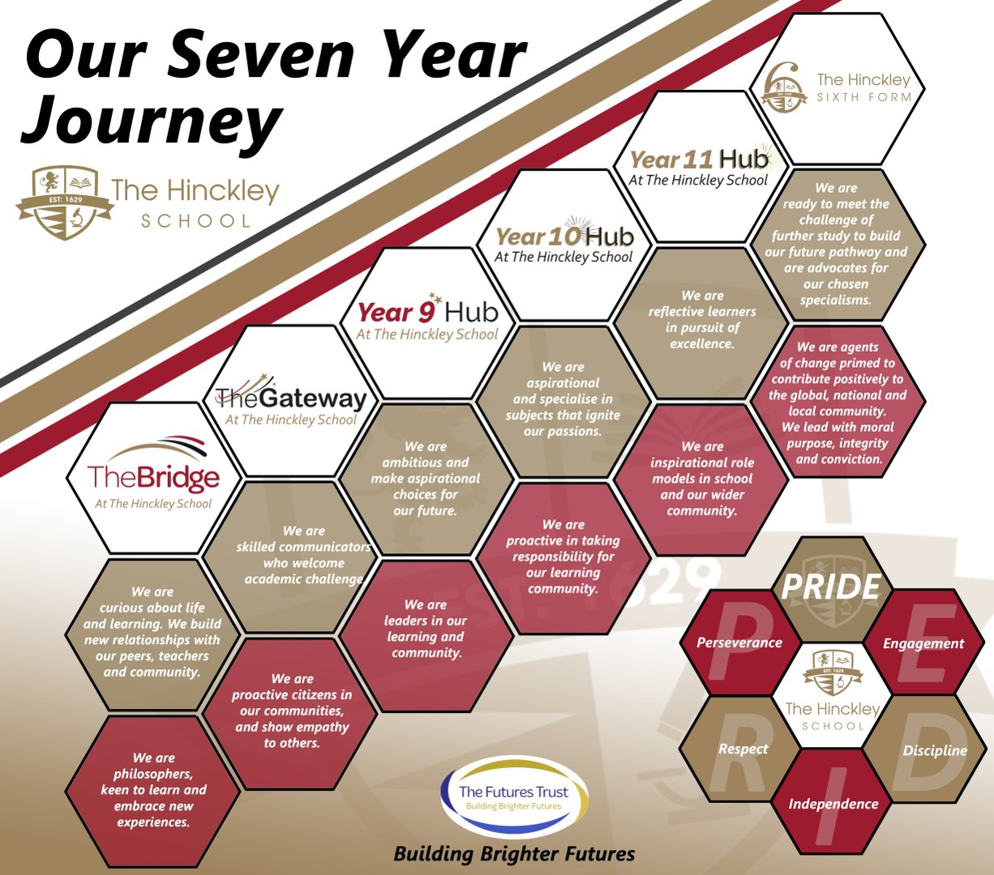

Slide 3
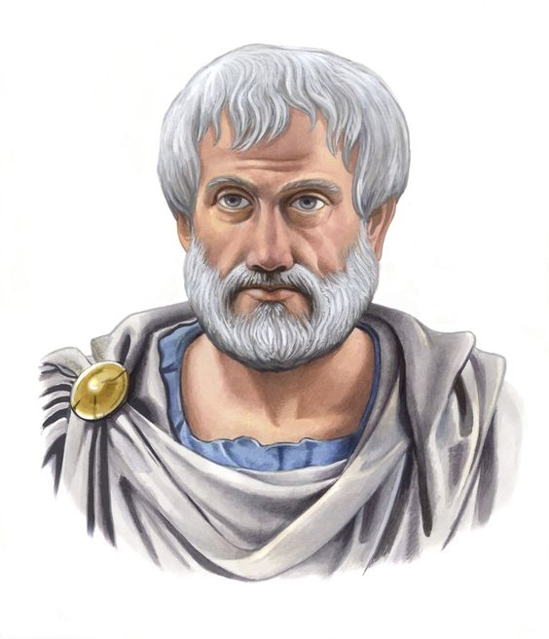
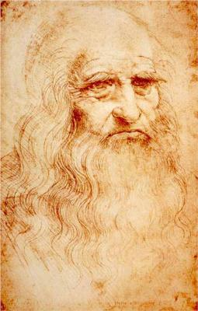
What is a ‘Philosopher’?
Have a love of wisdom
Are constantly questioning
Love debating
Can listen to other points of view

Slide 4
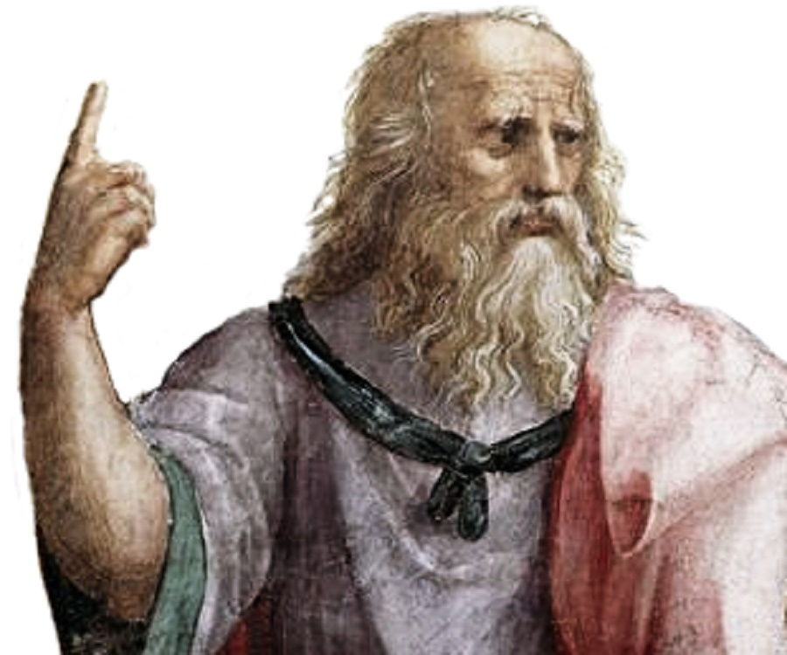
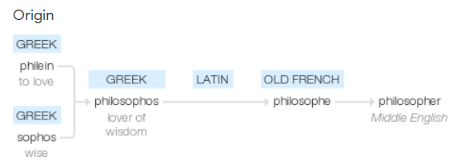
What is a Philosopher?

Slide 5
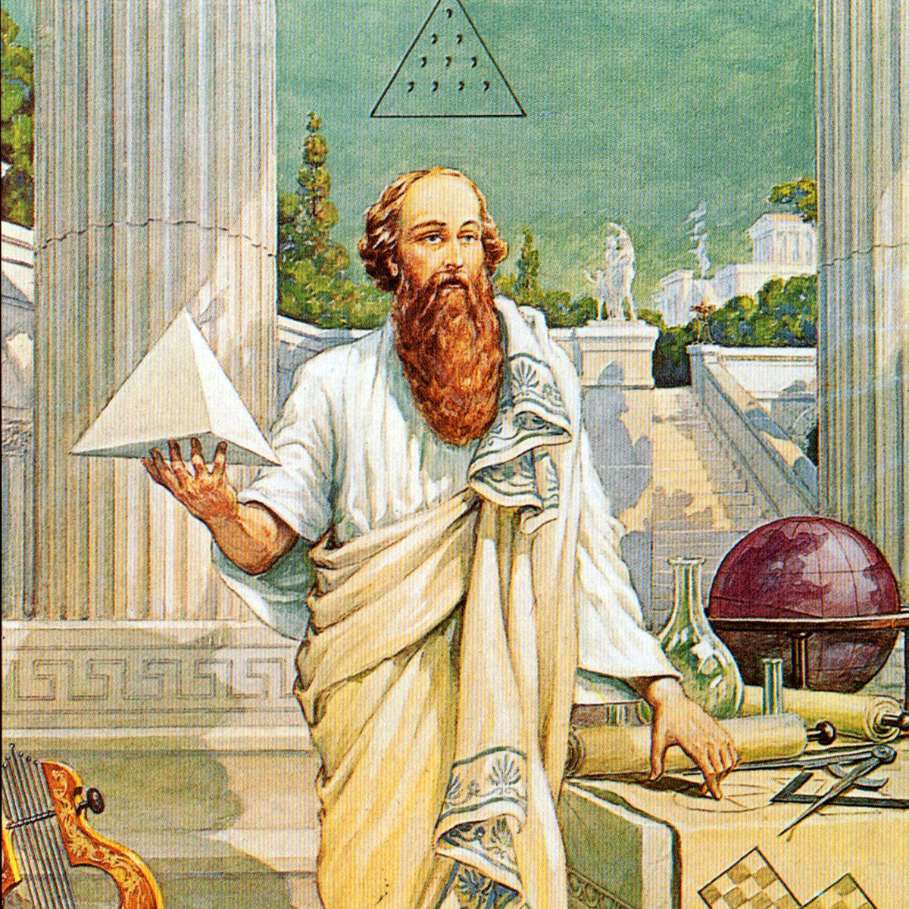
What is a ‘Philosopher’?
Actively seek to understand and question the world in which they live, and their relationships to the world and each other.
They are brave: many ancient philosophers, such as Socrates, were prepared to be die for their beliefs.

Slide 6
Three Key Questions – How can you be more philosophical?
Know | How | Show
Curious thinkers who challenge ideologies | Strive for academic excellence | Leader/driving force

Slide 7

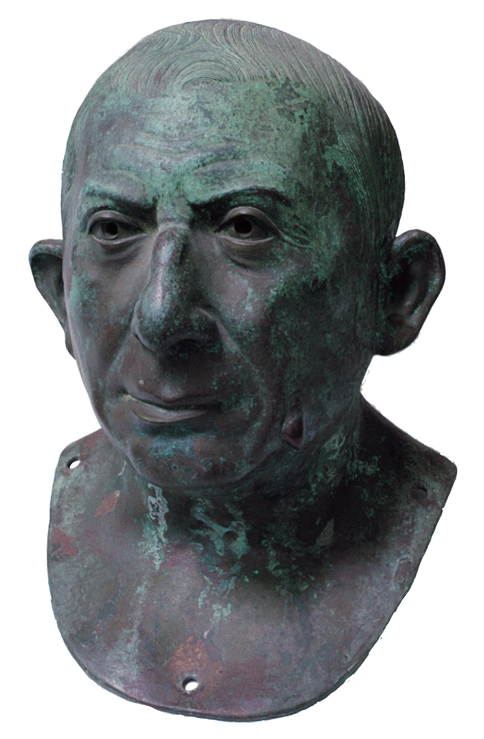
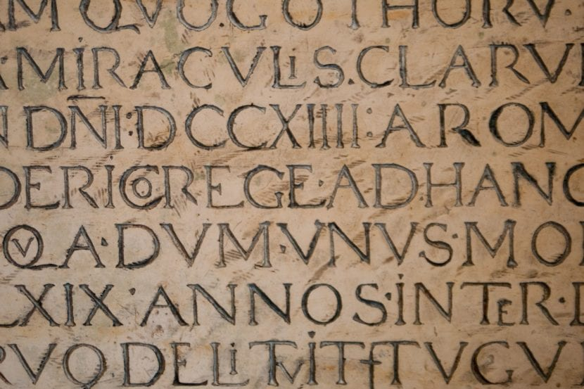
Classics and Latin in The Bridge

Slide 8
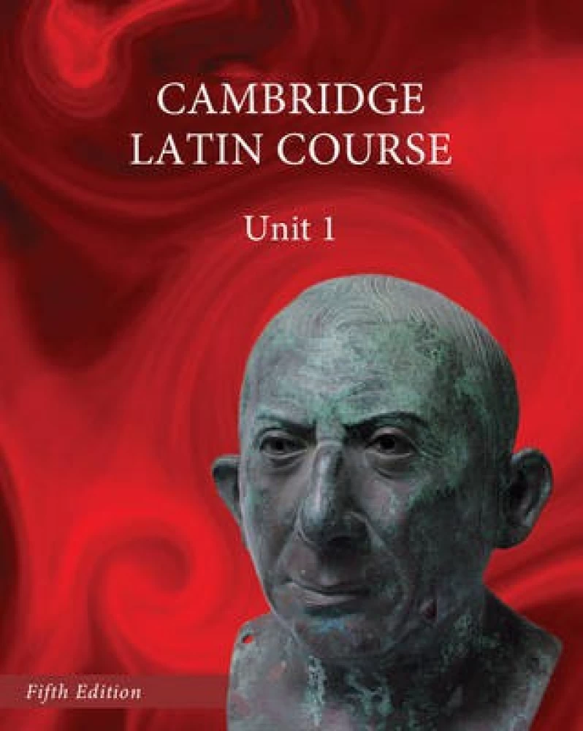
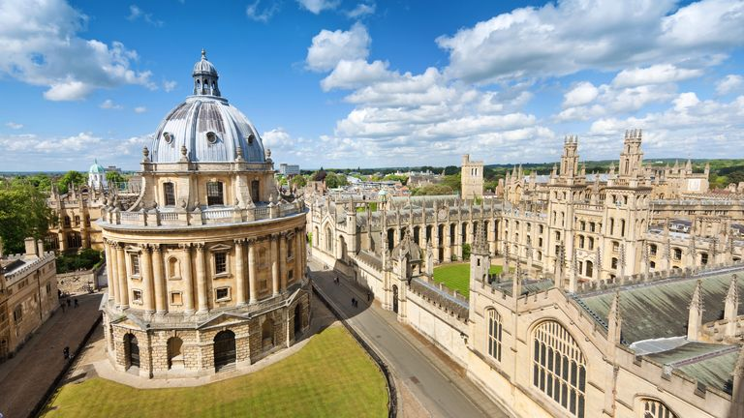
Aspirational Curriculum

Slide 9
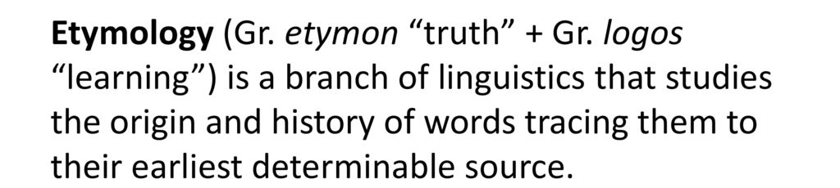
Etymology

Slide 10
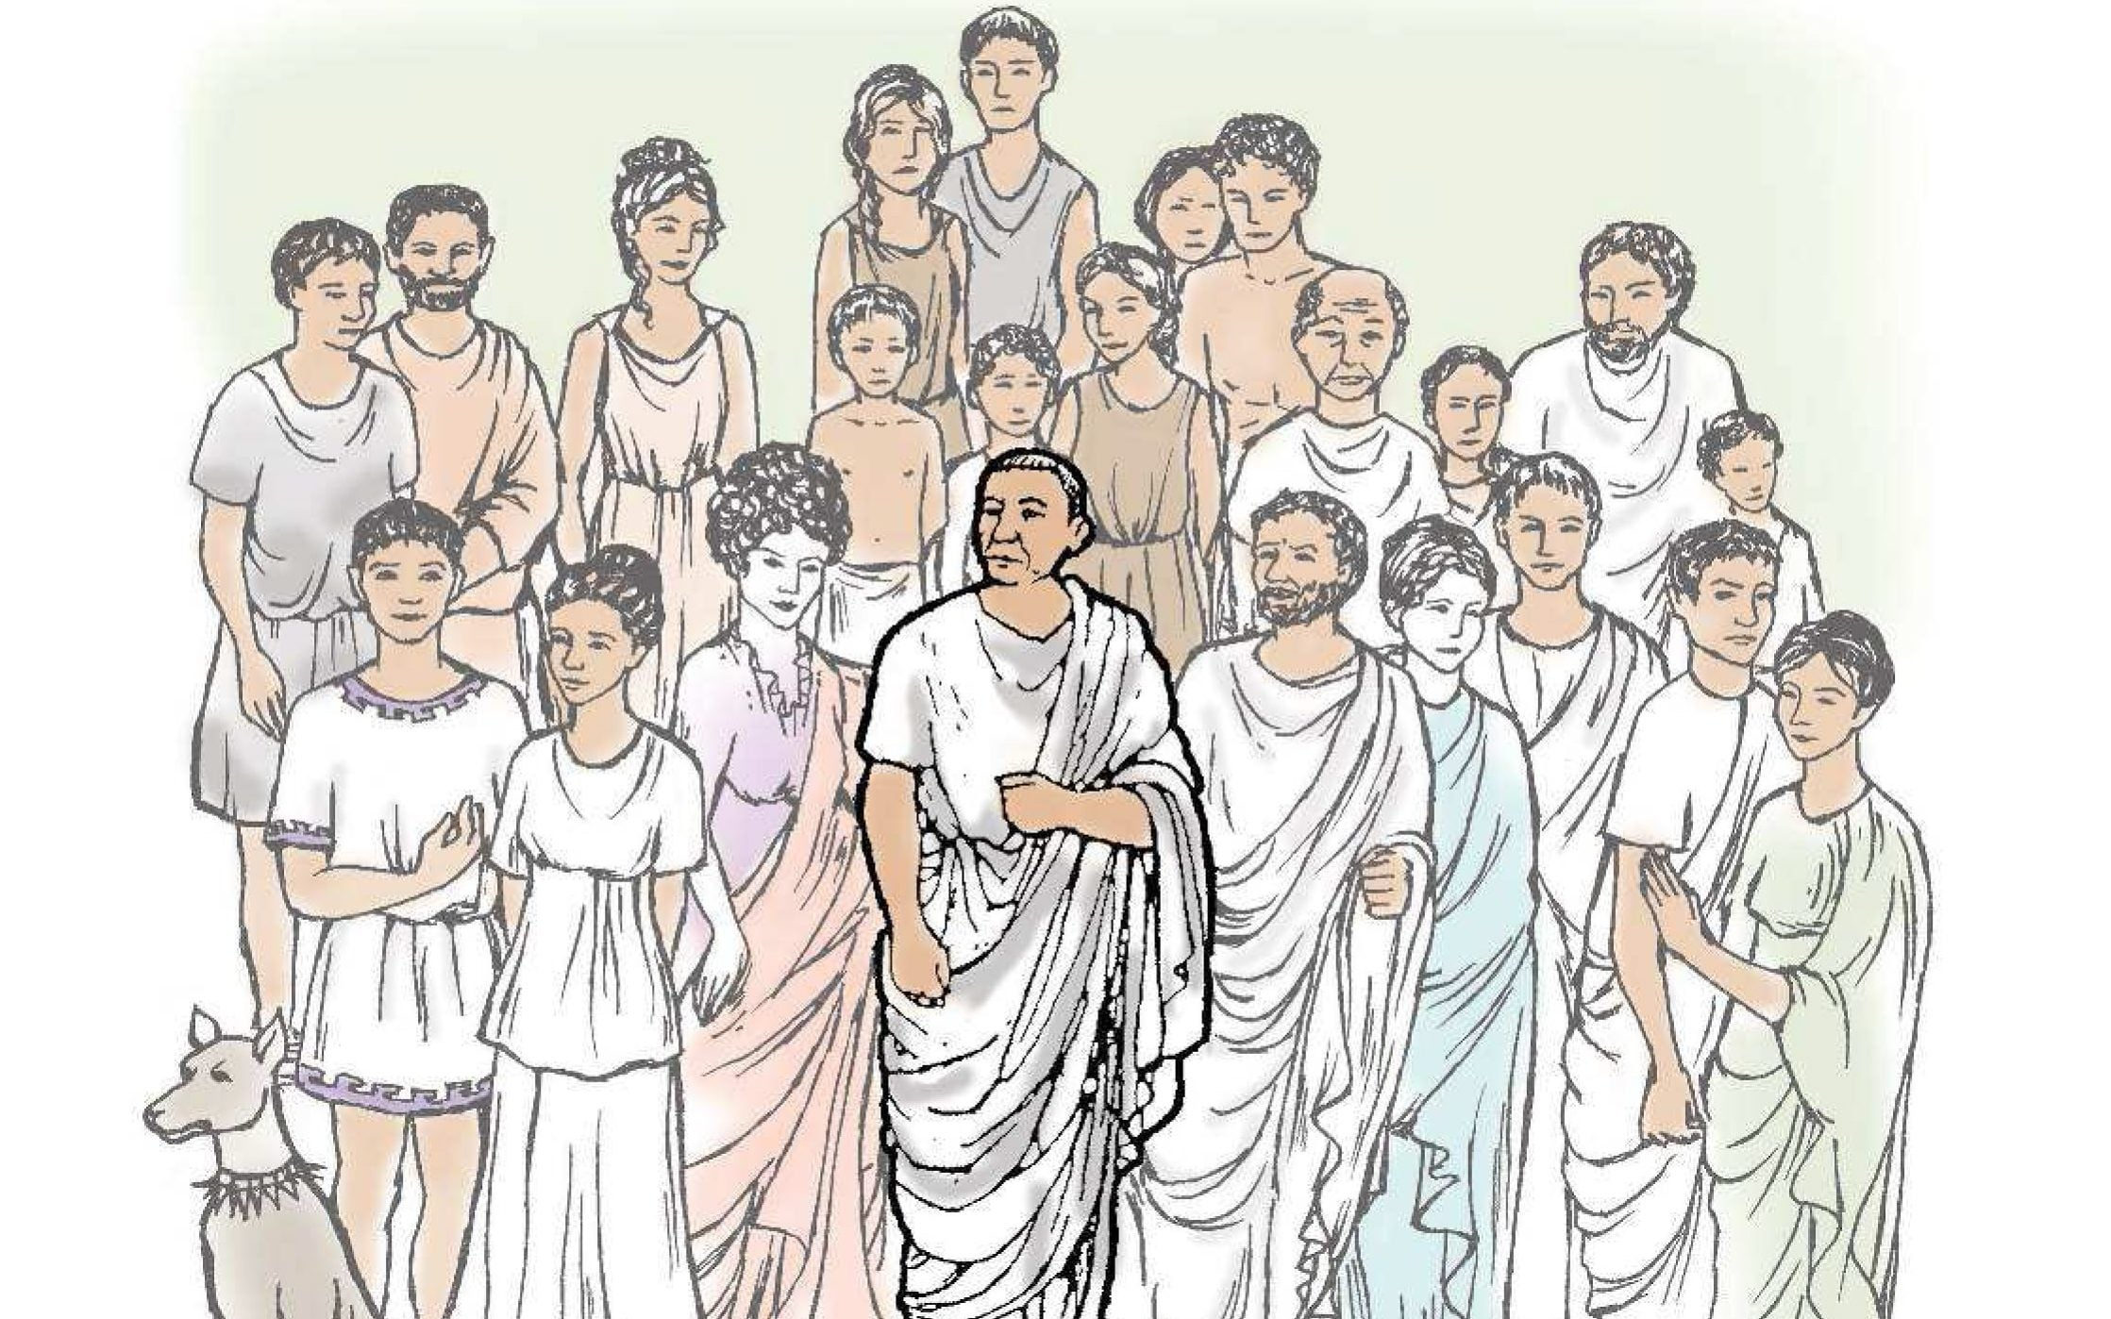
Student experiences of Classics

Slide 11
The importance of reading

Slide 12
The benefits of reading for pleasure
Children who read at least three times a week at age 16 gain higher results in maths, vocabulary and spelling tests at age 16 than those who read less regularly.
Being a successful reader makes it easier for students to absorb information across the curriculum
Increases emotional intelligence and the ability to empathise
Reduces stress factors and improves mental health
Reduces feelings of loneliness
Increases vocabulary knowledge, depth and understanding
Reading for pleasure is the single biggest indicator of a child’s future success – more than their family circumstances, their parents’ educational background or their income (Source: OECD).

Slide 13
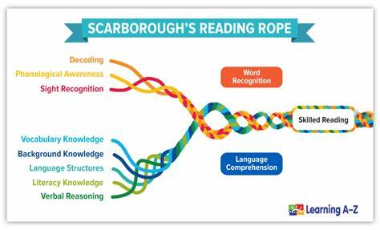
Learning to read

Slide 14
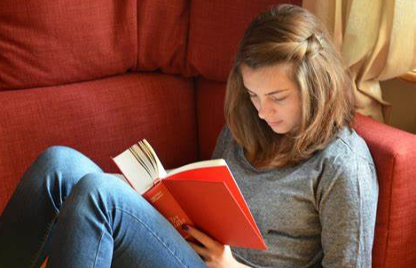
Ways to practise reading
Reading to an adult
Listening to an adult read including echo reading
Reading independently

Slide 15
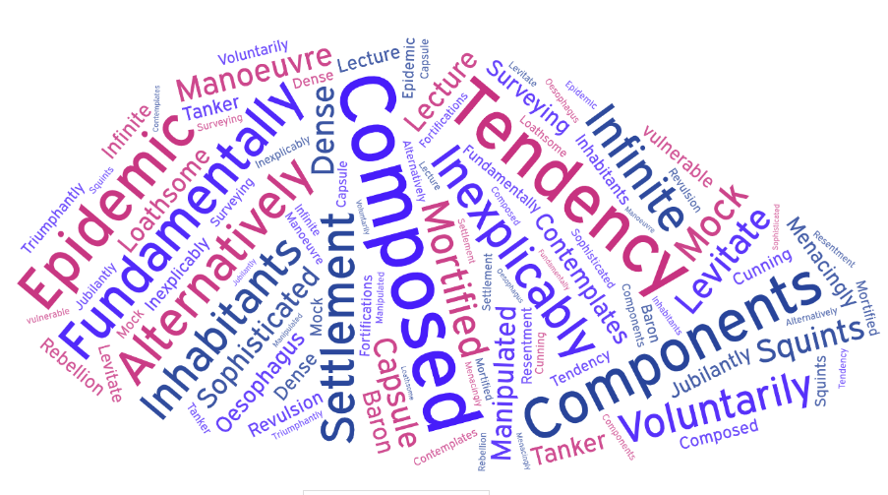
Vocabulary development

Slide 16
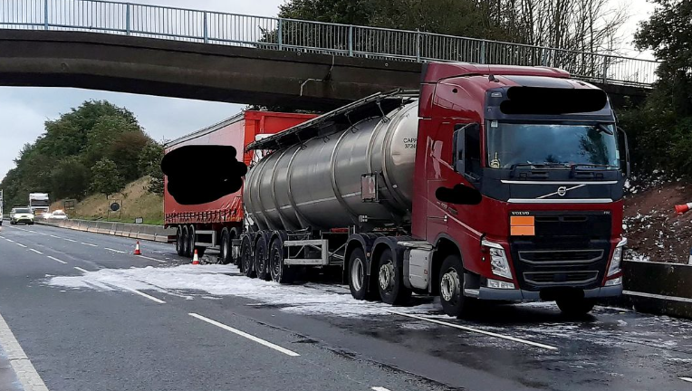
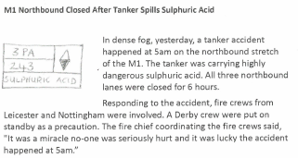

Listening to children read

Slide 17
Listening to children read
I was lucky that I won the lottery when I was 42 because by then I’d got a sensible head on my shoulders. I didn’t go mad and spend, spend, spend! It has made us happier, definitely. Before THE WIN, our family struggled to get by each week and now we don’t worry about money anymore. We don’t “flash the cash” but we give ourselves great holidays twice a year like a Safari or a week in New York.
Was Ellen well off before she won the lottery?

Slide 18









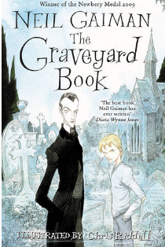

What should they read?

Slide 19

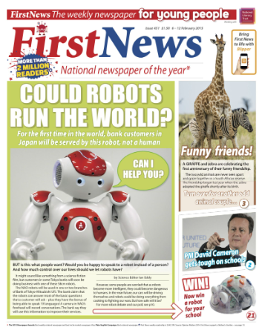
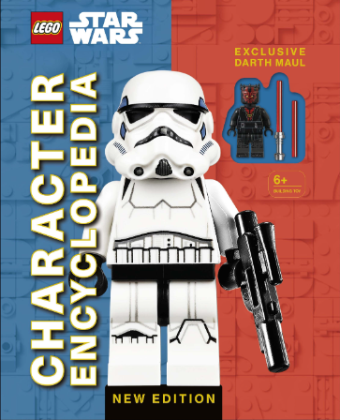
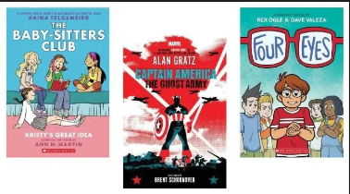
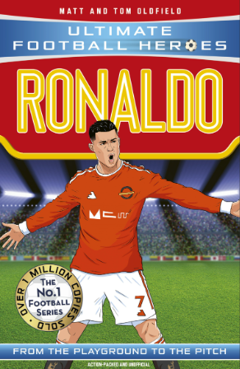
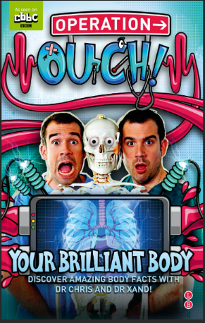




What should they read?

Slide 20
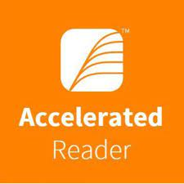
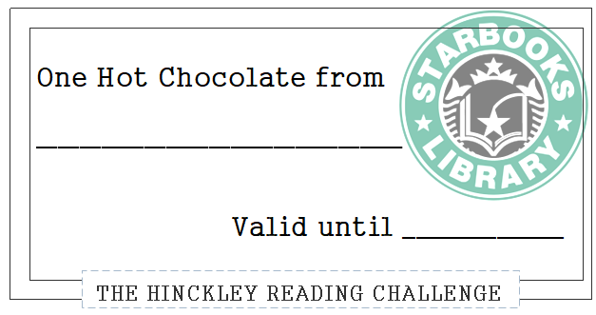
Accelerated Reader
Accelerated Reader is a computer program that helps teachers manage and monitor children's independent reading practice.
Your child picks a book at his/her own level and reads it at his/her own pace.
When finished, your child takes a short quiz on the computer. (Passing the quiz is an indication that your child understood what was read.)
Accelerated Reader gives both children and teachers feedback based on the quiz results.

Slide 21
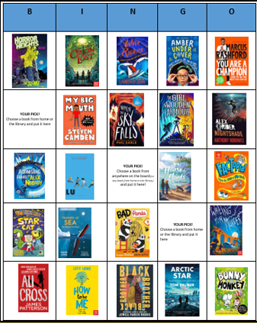
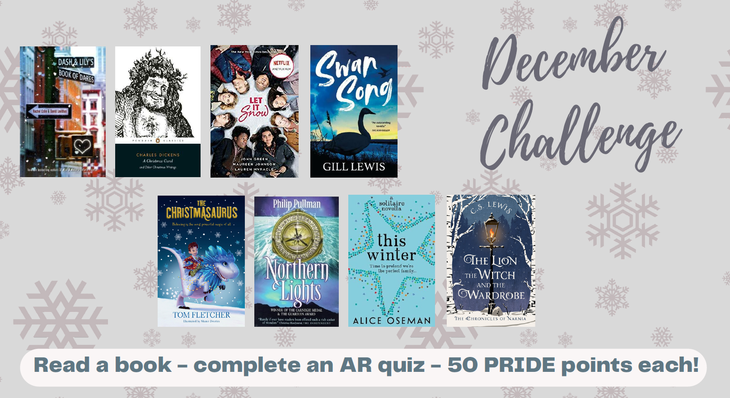
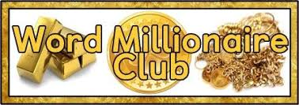
Reading Challenges

